Slide 1

Heart Attack Risk Factors in Japan: Youths & Adults
By Kushal Pindoria

Slide 2





OSEMN Framework
Obtain
Scrub
Explore
Model
Interpret
Imported dataset from Kaggle
Ensured the dataset was comprehensive
Cleaned missing values and standardized columns.
Unpivoted categorical data for better visualization
Identified key heart attack risk factors.
Analysed trends
Created measures and columns using DAX
Built slicers for cholesterol, BMI, age, region and gender
Designed three interactive dashboards
Recommendations for tailored health interventions and policy changes.
Notes:
Within this project I implemented the OSEMN framework, providing recommendations to reduce heart attack occurrences for youths and adults. Obtain: The dataset was sourced from Kaggle and by reading and looking through the data I ensured that the dataset was comprehensive for analysis.
Scrub: Missing values were cleaned, columns standardized, and categorical data unpivoted for better visualization using tools on PowerQuery.
Explore: Trends and correlations were identified through exploratory data analysis.
Model: Interactive dashboards were built using Power BI to visualize key findings, and also included slicers to filter down the results
Interpret: Insights were analysed, and recommendations were developed for tailored health interventions and policy changes."

Slide 3
Project Understanding
Project Task
Pick a dataset to analyse and produce a PowerBI visualisation
2. Japan Heart Attacks
Focuses on Heart Attacks between Youths and Adults
3. Risk Factors
Chose to analyse different risk factors and how they collate with heart attacks
4. Key Question
What is the top health risk factor for heart attacks in adult males with moderate cholesterol, urban residence, and alcohol consumption?
5. Project Aims
Leverage data insights to identify key risk factors and develop strategies to reduce heart attack occurrences through targeted prevention
Notes:
"This project looks at heart attack risk factors in youths and adults in Japan. Heart attacks are a serious public health issue, and understanding the differences in risk factors between age groups can help design better prevention strategies.
I focused on analyzing medical, lifestyle, and behavioral data to find trends and key contributors to heart attacks. One question that guided this analysis was: ‘What is the main risk factor for heart attacks in adult males with moderate cholesterol, living in urban areas, and consuming alcohol?’
The goal was to turn these insights into actionable recommendations, like targeted health campaigns and policies, to reduce heart attack risks and improve public health outcomes."

Slide 4
Data Understanding
Column Name | Description | Data Type | Example Values
Age | Age of the individual (in years) | Numeric (Integer) | 25,33
Gender | Gender of the individual | Categorical | Male, Female
Region | Region where the individual resides | Categorical | Urban, Rural
Smoking History | Whether the individual has a history of smoking | Categorical | Yes, No
Diabetes History | Whether the individual has a history of diabetes | Categorical | Yes, No
Hypertension History | Whether the individual has a history of hypertension | Categorical | Yes, No
Cholesterol Level | Cholesterol level of the individual (mg/dL) | Float | 185.14, 223.81
Physical Activity | Level of physical activity performed by the individual | Categorical | Low, Moderate, High
Diet Quality | Quality of the individual’s diet | Categorical | Poor, Average, Good
Alcohol Consumption | Level of alcohol consumption by the individual | Categorical | None, Low, Moderate, High
BMI | Body Mass Index of the individual (kg/m²) | Float | 14.97, 26.95
Family History | Whether the individual has a family history of heart attacks | Categorical | Yes, No
Heart Attack Occurrence | Whether the individual has experienced a heart attack | Categorical | Yes, No
Column Name | Description | Data Type | Example Values
Index | A unique identifier for each record in the dataset | Numeric (integer) | 1, 2
Systolic BP | The systolic blood pressure reading (in mmHg) for the corresponding record | Float | 97.5, 65.2

Slide 5
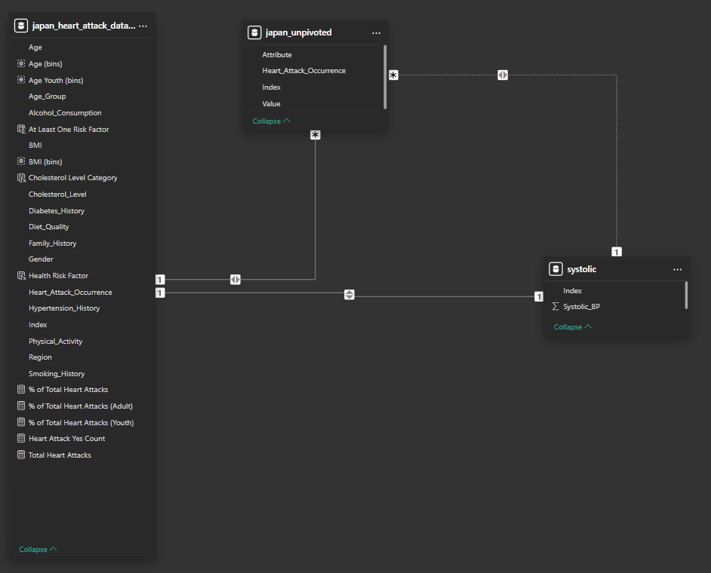
Dataset Relationships

Slide 6
Power Query

Slide 7
PowerBI

Slide 8
Summary
Key Findings
Among youths, the age of 19 has the highest number of heart attacks, while for adults, the age group between 28 and 35 experiences the highest number of heart attacks.
Smoking history is the leading risk factor contributing to the total number of heart attacks for both youths and adults.
Recommendations
Anti-Smoking Campaigns in Schools and Universities
Health Screenings and Interventions
Workplace Wellness Programs
Routine Heart Health Assessments

